Slide 1
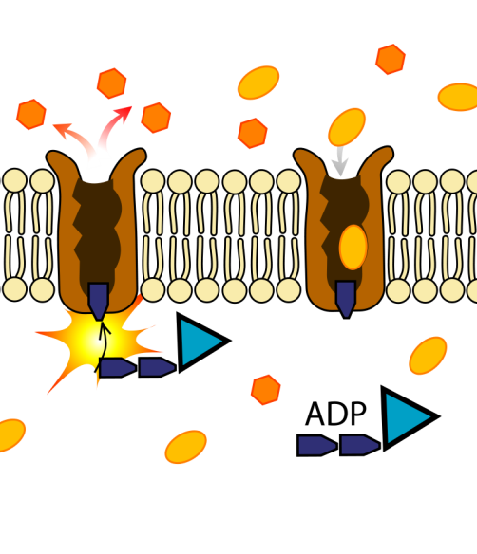
Active Transport
Lesson Objectives:
Define active transport and state why it requires energy
Describe where it happens in living organisms
Starter- LO1 and recap
Write a definition for diffusion and osmosis
How are they different and how are they similar?
Review: Discuss

Slide 2
Moving down a concentration gradient
Which way will the particles move?
Diffusion
Osmosis

Slide 3
Moving UP or against a concentration gradient
ENERGY
The particles can move up the concentration gradient if energy is used
Active Transport
Write a definition for active transport

Slide 4
Define active transport and state why it requires energy.
Active transport is the movement of particles against a concentration gradient, i.e. from an area of lower concentration to an area of higher concentration, it is an active process using energy during respiration.
Active transport requires energy as it moves against the concentration gradient!
Remember: This difference in concentration is called the concentration gradient
Review:
Be prepared to share your ideas

Slide 5
Define active transport and state why it requires energy.
2) Why does active transport require energy?
Complete this sentence about active transport using the words below.
1) Active transport is the spreading out of __________ from an area of _______ ________ to an area of ______ _______, it is an ________ process which moves _______ the concentration gradient.
Review:
Be prepared to share your ideas

Slide 6
Achieving Objective:
Describe where active transport happens in living organisms
Active transport
Along with diffusion and osmosis , active transport can be used to move substances in and out of cells for various processes
Cells can absorb ions from very dilute solutions…

Slide 7
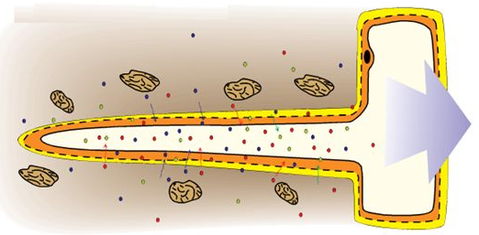
Achieving Objective:
Describe where active transport happens in living organisms
Plants – root hair cells
Mineral ions (such as nitrates) are absorbed from the soil
These are needed for healthy growth
The concentration of water in the soil may be high, but the concentration of mineral ions are low
Mineral ions must be exchanged via active transport

Slide 8
Achieving Objective:
Describe where active transport happens in living organisms
Animals – in the gut
Glucose, amongst other substances e.g. minerals
Villi cells in the small intestine use active transport alongside diffusion to maximise their absorption
This glucose is needed for respiration
Notes:
To get the most out of the food, we must keep drawing nutrients once diffusion stops.
This means we have to expend energy and use active transport to move the nutrients against the concentration gradient.

Slide 9
Achieving Objective:
Describe where active transport happens in living organisms
Task questions
Why do plants need to take up mineral ions?
Why do root hair cells need to use active transport to take mineral ions up from the soil?
Name one molecule that is taken up by active transport in the gut
Outline an example of active transport happening in plants and animals
Review: Random pick

Slide 10
Plenary
Quick Quiz
Give an example of an active process.
What does active mean?
Define the term concentration gradient.
Give an example of a mineral ion.
Which cell is responsible for absorbing glucose via active transport in the small intestine?

